Slide 1



ATMAN – A Bridge of Love and Legacy
Reducing Loneliness & Preserving Wisdom Through AI

Slide 2
Table of Contents:
1.Introduction
2.Objectives
3.Methodology Overview
4.Technology Stack
5.System Architecture
6.Database Design
7.Core Modules
8.Voice Assistant Module
9.AI Chatbot Module
10.Memory Management
11.Family Dashboard
12.Admin Dashboard
13.Security & RLS Policies
14.UI/UX Design Principles
15.Emotion Detection Algorithm
16.Testing &Results
17.Screenshots & Demo
18.Future Scope
19.Conclusion
20.References

Slide 3

Introduction & Problem Statement:
The Growing Need:
India has 140M+ elderly population (2026), expected to double by 2050
71% of elderly live without regular family interaction
Loneliness leads to cognitive decline, depression, and health issues.
The Problem:
Families are geographically separated
Elders struggle with modern technology
Limited accessible communication tools for seniors
Precious memories and wisdom are lost
Our Solution:
ElderConnect: An AI companion designed specifically for seniors with voice interaction, memory preservation, and family connectivity

Slide 4

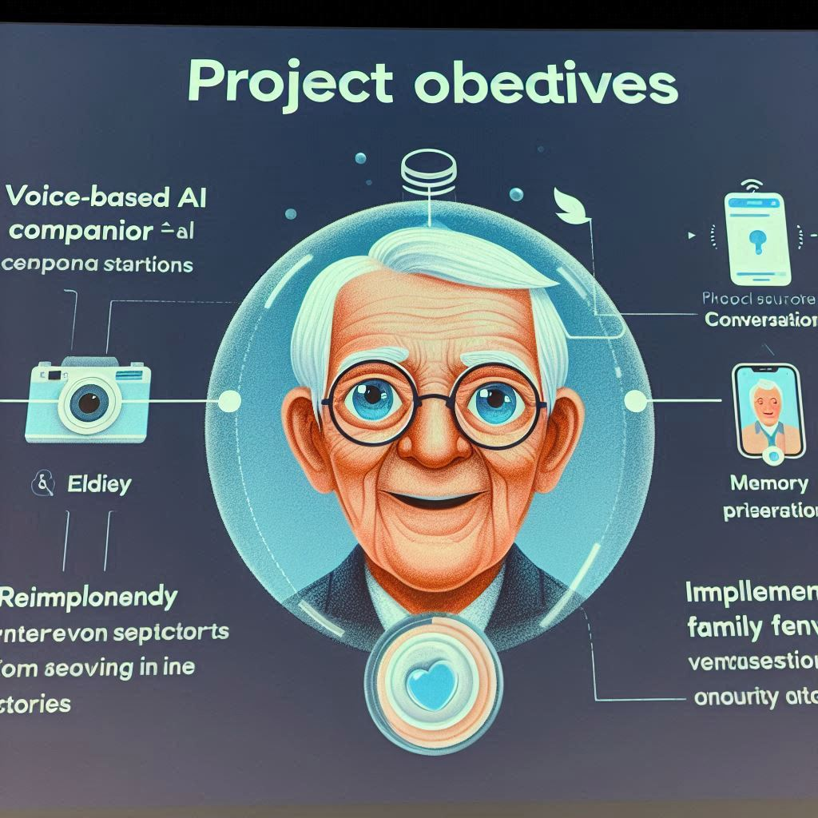
Project Objectives:
Primary Objectives:
Develop a voice-based AI companion for natural conversations.
Create an accessible, elderly-friendly user interface.
Build a memory preservation system for storing life stories.
Enable family members to view conversations and updates.
Implement emotion detection during voice interactions.
Secondary Objectives:
Multi-language support (English & Hindi).
Role-based access control (Elder, Family, Admin).
Real-time conversation synchronization.
WCAG-compliant accessibility features.

Slide 5
Methodology - Development Approach:
Phase | Activities | Duration
Research | User studies, elderly needs analysis | 2 weeks
Design | UI/UX prototyping, database schema | 3 weeks
Development | Frontend + Backend implementation | 8 weeks
Testing | User acceptance testing with seniors | 2 weeks
Deployment | Cloud deployment & optimization | 1 week
Key Techniques:
Component-based architecture
Progressive enhancement for accessibility
Real-time database synchronization
Edge functions for AI processing

Slide 6
Technology Stack:
Layer | Technology | Purpose
Frontend | React 18 + TypeScript | Custom-built, type-safe UI
Styling | Tailwind CSS + shadcn/ui | Elder-friendly accessible design
Build Tool | Vite | Fast development & bundling
Backend | Supabase (PostgreSQL) | Database, authentication,APIs
AI/ML | Google Gemini API | Custom-built conversational AI logic
Voice | Web Speech API | Speech-to-text & text-to-speech
Hosting | Cloud Infrastructure (Self-Deployed) | Manually deployed application on cloud

Slide 7

System Architecture:
Elder App
Family App
Admin App
Client Layer
React Frontend
Application Layer
Supabase Edge Function
Custom NLP Model
Voice Processing
PostgreSQL Database
Data Layer
Custom chatbot
Conversation
Memories
Profiles
Updates
External Services

Slide 8

Database Design (ER Diagram):
Pofiles
uuid | id | PK
string | email
string | full_name
enum | role
timestamp | created_at
has
creates
Conversations
uuid | id | PK
uuid | elder_id | PK
string | question
string | answer
string | conversation_type
string | emotion
string | language
timestamp | created_at
Memories
uuid | id | PK
uuid | elder_id | PK
string | title
text | content
string | memory_type
timestamp | created_at
receives
assigned
UPDATES
USER_ROLES

Slide 9
Core Modules Overview:
System Modules and Responsibilities
Module Name | Description | User Type
Authentication | Secure login and registration with role-based access control | Elder, Family, Admin
Voice Assistant | Real-time voice interaction with AI companion | Elder
AI Chatbot | Text-based conversational interface for daily interaction | Elder
Memory Keeper | Storage and organization of life stories and memories | Elder
Admin Dashboard | User management, data monitoring, and system control | Admin
Emotion Detection | Voice-based emotional state analysis for wellbeing insights | System

Slide 10
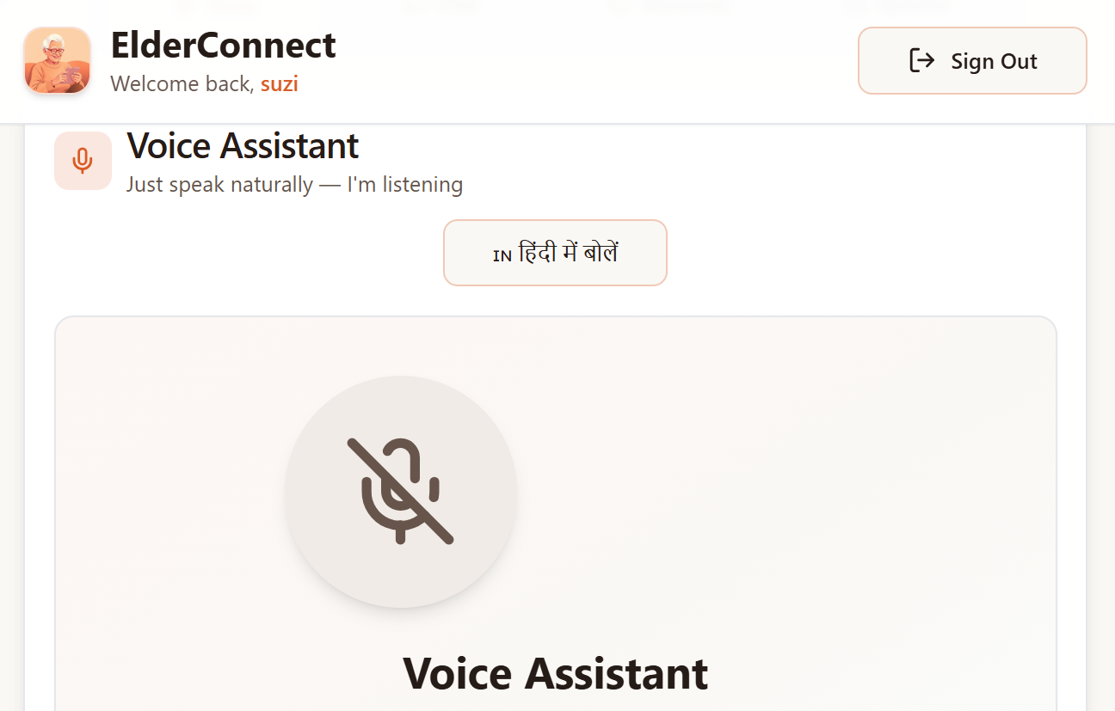
Voice Assistant Module:
Key Features:
Natural speech recognition for easy interaction
Text-to-speech responses for human-like replies
🇮🇳 Bilingual support (English & Hindi)
Real-time emotion detection from voice input
Automatic saving of all conversations
Technical Implementation:
javascript
Voice Recognition Flow
Web Speech API → Transcript → AI Processing →
Supabase Edge Function → Gemini AI →
Response → Speech Synthesis → Database Save.
Emotion Detection Algorithm:
Analyzes audio frequencies in real-time
Detects: Happy, Sad, Calm, Excited, Neutral
Adjusts AI responses based on emotional state

Slide 11

AI Chatbot Module:
Elder
Chat Interface
Edge Function
Custom NLP Model AI
Database
Type Message
Send with user context
Process with system prompt
Generate response
Return response
Save conversation
Display with TTS option
Elder
Chat Interface
Edge Function
Custom NLP Model AI
Database

Slide 12
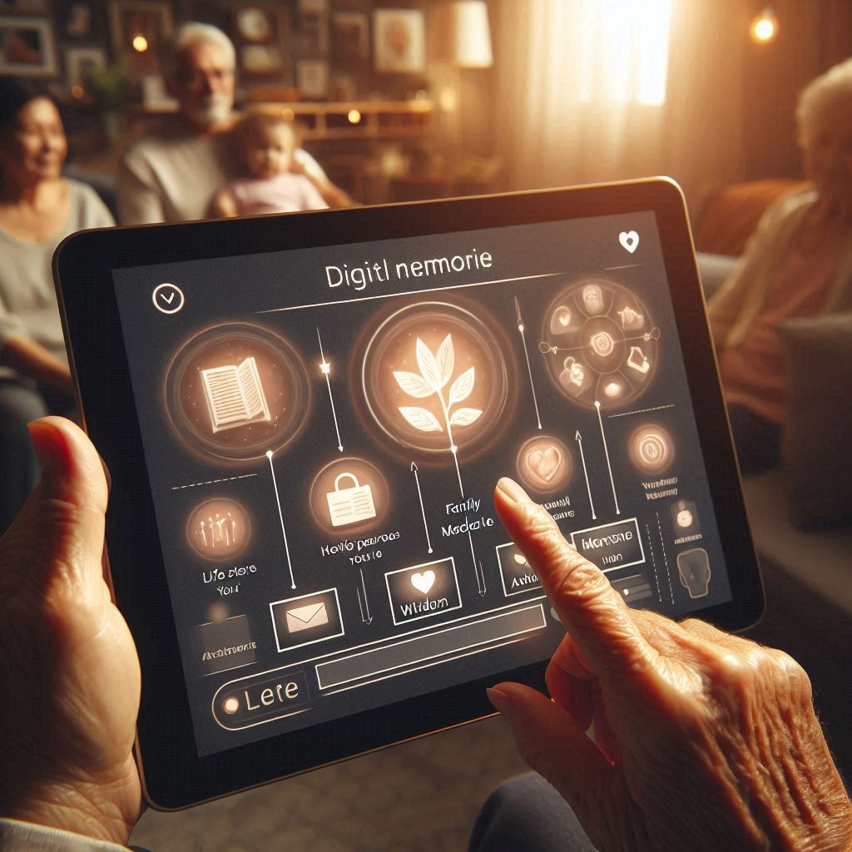

Memory Management System:
Purpose:
To digitally preserve elders life stories, wisdom, and personal experiences, ensuring they remain accessible to family members across generations.
Types of Memories Stored:
Life Stories-Important events, childhood memories, struggles, and milestones
Wisdom & Advice-Guidance shared during conversations or directly recorded by elders
Family Memories-Moments related to family relationships and traditions
Travel Experiences-Journeys, places visited, and cultural experiences
Achievements-Personal, professional, and life accomplishments
Features: -
Simple form interface with large inputs.
Category tagging.
Timestamp tracking.
Family access for viewing.
Search and filter capabilities give this in more detail.

Slide 13
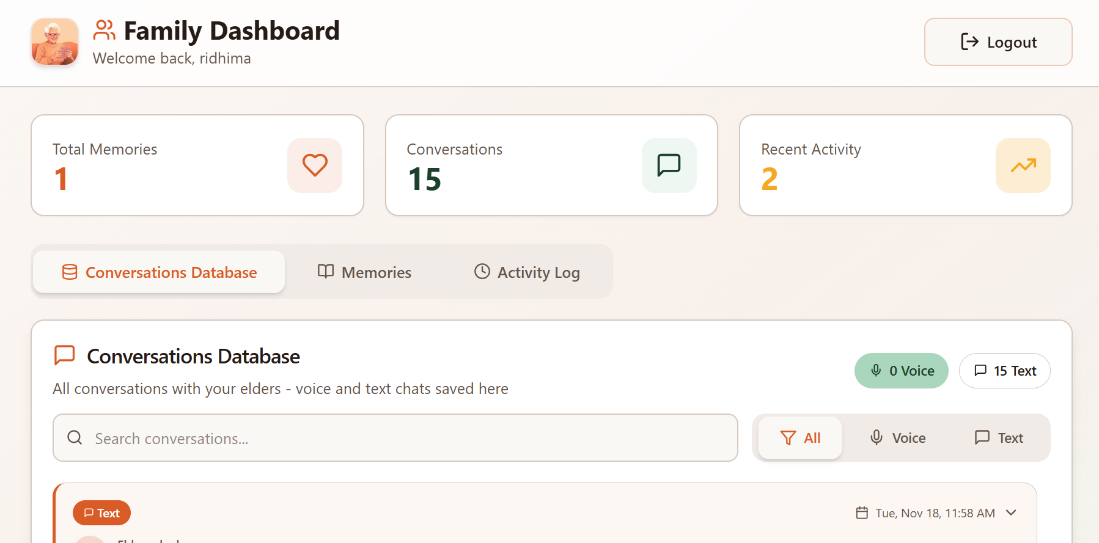

Family Dashboard:
Purpose:
Keep families connected with their elders.
Key Features:
Security:
Row Level Security ensures families only see their elder's data
Feature | Description
Conversation History | View all text & voice chats
Emotion Insights | See emotional state during calls
Memory Access | Read all stored memories
Activity Timeline | Track elder's engagement
Search & Filter | Find specific conversations

Slide 14
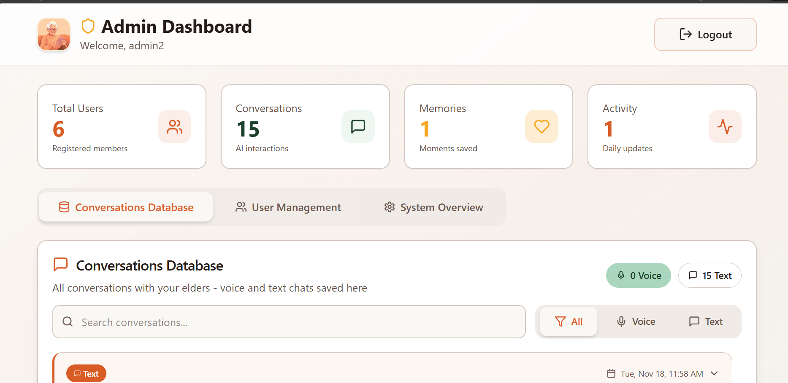

Admin dashboard:
Core Capabilities:
User Management Create, update, view, and delete elder, family, and admin accounts
System-Wide Statistics Overview of active users, interactions, and memory entries
Conversation Access View stored AI–elder conversations for monitoring and improvement
Role Assignment Assign and manage roles with appropriate access permissions
Usage Analytics Track system usage patterns and feature engagement
Admin-Specific Features:
View all registered users across different roles
Manage user accounts and access rights
Access aggregated and anonymized system data
Monitor overall system health and performance

Slide 15

Security Implementation:
Row Level Security (RLS) Policies:
sql
Elders see only their data
CREATE POLICY "Elders view own conversations"
ON conversations FOR SELECT
USING (elder_id = auth.uid());
Families see elder data (requires relationship)
CREATE POLICY "Families view conversations"
ON conversations FOR SELECT
USING (has_role('family', auth.uid()));
Admins see everything
CREATE POLICY "Admin full access"
ON conversations FOR ALL
USING (has_role('admin', auth.uid()));
Security Features:
JWT-Based Authentication: Uses JSON Web Tokens to securely authenticate users and maintain session integrity without storing passwords on the client side.
Role-Based Access Control (RBAC): Restricts system features and data access based on user roles such as elder, family member, or admin.
Encrypted Data Transmission: All data exchanged between client and server is encrypted using HTTPS to prevent unauthorized access or interception.
Secure API Key Management: API keys are stored securely in server-side environment variables and never exposed on the client side.

Slide 16

Accessibility & UI/UX Design:
WCAG 2.1 Compliance:
Principle | Implementation
Perceivable | High contrast (7:1), large fonts (18px base)
Operable | Keyboard navigation, skip links
Understandable | Simple language, clear labels
Robust | Semantic HTML, ARIA attributes
Elderly-Specific Design:
Minimum 18px Font Size: Ensures text is easily readable for elders with reduced vision and avoids eye strain.
Warm Color Palette (Teal, Coral, Cream): Uses soothing and high-contrast colors to create a calm, friendly, and welcoming interface.
Large Touch Targets (48px+): Provides bigger buttons and controls to reduce misclicks and support users with limited motor precision.
Slow, Gentle Animations: Prevents confusion and discomfort by keeping transitions smooth and easy to follow.
Audio Feedback Support: Confirms user actions through sound cues, improving usability for elders with visual limitations.

Slide 17

Emotion detection algorithm:
Approach: Audio frequency analysis for emotional state detection.
Excited/
Happy
High Energy
Classify Pattern
Calm
Audio Input
Frequency Analysis
Steady Rhythm
Adjust Ai Response
Sad
Low Frequency
Implementation:
Web Audio API for Real-Time Analysis: Captures and processes live voice input to extract audio features
during conversations.
Audio Sampling Every 500ms: Voice data is analyzed at regular 500ms intervals to track emotional changes accurately.
Emotion Mapping Logic: Extracted frequency and intensity patterns are mapped to basic emotional states such as calm, happy, or stressed.
Emotion-Linked Storage: Each detected emotional state is stored along with the corresponding conversation for later analysis and insights.
Normal
Neutral

Slide 18

Testing and results:
Testing Methodology:
Test Type | Description | Status
Unit Testing | Component-level tests | Passed
Integration Testing | API & database | Passed
User Acceptance | Testing with seniors (n=10) | Passed
Accessibility Audit | WCAG compliance check | Passed
User Feedback Results:
95% found voice interface easy to use
90% felt emotionally supported
100% families appreciated conversation access
Average session duration: 15 minutes

Slide 19


Future scope:
Planned Enhancements
Photo Memories Enable elders to upload images along with stories for richer memory preservation.
Voice Memos Allow audio-only recordings for elders who prefer speaking over typing.
Real-Time Notifications Notify family members about important activities, updates, or emotional changes.
Mobile Application Develop native Android and iOS apps for improved accessibility and portability.
Advanced AI Personalization AI will proactively ask personalized questions to help elders recall and record memories.
Health Integration Include medication reminders and basic health tracking features.
Multi-Elder Support Support families managing profiles of multiple elders within one account.
Multilingual Expansion Add support for regional and international languages for broader accessibility.

Slide 20

Conclusion and References:
Summary:
ElderConnect successfully addresses the critical need for elderly companionship through:
Accessible voice & text AI conversations
Secure memory preservation system
Family connectivity dashboard
Emotion-aware interactions
WCAG-compliant accessible design
Key Achievement:
Created a bridge between generations using AI, preserving wisdom while combating elderly loneliness.
References:
1. WHO. (2024). Aging and Health Report
2. React Documentation. https://react.dev
3. Supabase Documentation. https://supabase.com/docs
4. WCAG 2.1 Guidelines. https://www.w3.org/WAI/WCAG21
5. Google Gemini API. https://ai.google.dev

Slide 21
Thank you……….

